Slide 1


BigMart
Created by:Kyrillos Ayman

Slide 2
case story
BigMart is a large retail chain operating across multiple cities, selling thousands of products ranging from food and beverages to household items. The management has noticed significant variations in sales across different stores, with some products performing very well in certain stores while performing poorly in others.
The company aims to understand the factors affecting sales for each product and each store, in order to make informed business decisions. The goal is to improve overall sales and increase profitability by analyzing the available data on products, stores, and past sales.

Slide 3
Business Questions
Which products achieve the highest sales acrossall stores?
Is there a relationship between product type(Item_Type) and sales?
Which stores (Outlet_Identifier) achieve the highestand lowest sales?
Does the store size (Outlet_Size) affect salesperformance?
Does the store location type(Outlet_Location_Type) impact sales?
Does the product price (Item_MRP) influence salesvolume?
Which products have low salesand might requirefurtheranalysis?
Which product categories requireincreasedinventory in high-performing stores?
Is there a relationship betweenproduct attributes(e.g., weight,fat content) and salesperformance?

Slide 4
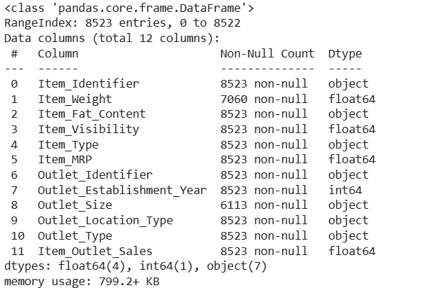
Dataset Overview
This dataset contains historical sales records for products sold across multiple outlet stores.
It includes detailed information about items, store characteristics, and sales performance, making it suitable for retail analytics, demand forecasting, and store-level performance analysis.
🔹 Number of records:
≈ 8,500 rows (after cleaning)
🔹 Number of features (columns):
11 features after preprocessing
(including engineered features such as Outlet_Age and Weight_Category)

Slide 5

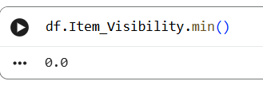

Data Issues
Missing Values in Item_Weight
Zero Values in Item_Visibility
Inconsistent Categorical
  The Item_Weight column had several missing values, which can distort statistical analysis and model training.
  Item_Visibility had many zeros, which is impossible in real-life retail data (an item always has some visibility).
  These zeros negatively impact correlation, sales relationships, and model results.
  The column contained duplicates written differently:
  "Low Fat", "LF", "low fat"
  "Regular", "reg"

Slide 6
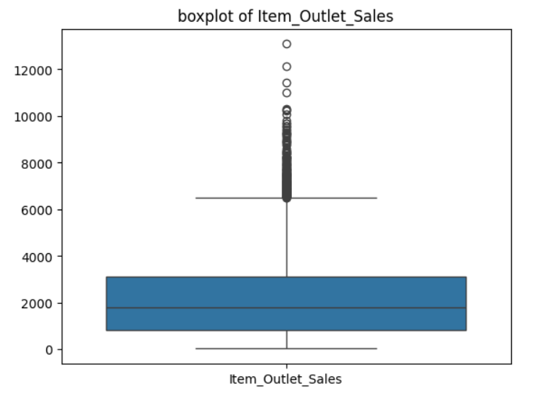

Data Issues
Missing Values in Outlet_Size
Outliers in Item_Outlet_Sales
Creation of Engineered Features
  Outlet_Size had missing values.
  Sales had extreme outliers → skew results, distort visualization, affect ML models.
  Raw data lacked some useful business variables.

Slide 7
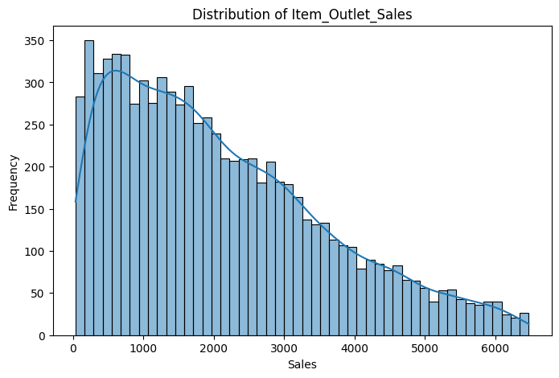
The plot is a Histogram showing the distribution of the Item_Outlet_Sales variable. The distribution is highly right-skewed (positively skewed). The majority of sales transactions are concentrated in the lower range, peaking near the $500 - $1000 mark. The frequency gradually decreases as sales values increase, indicating that high sales figures (above $4000) are relatively rare.

Slide 8
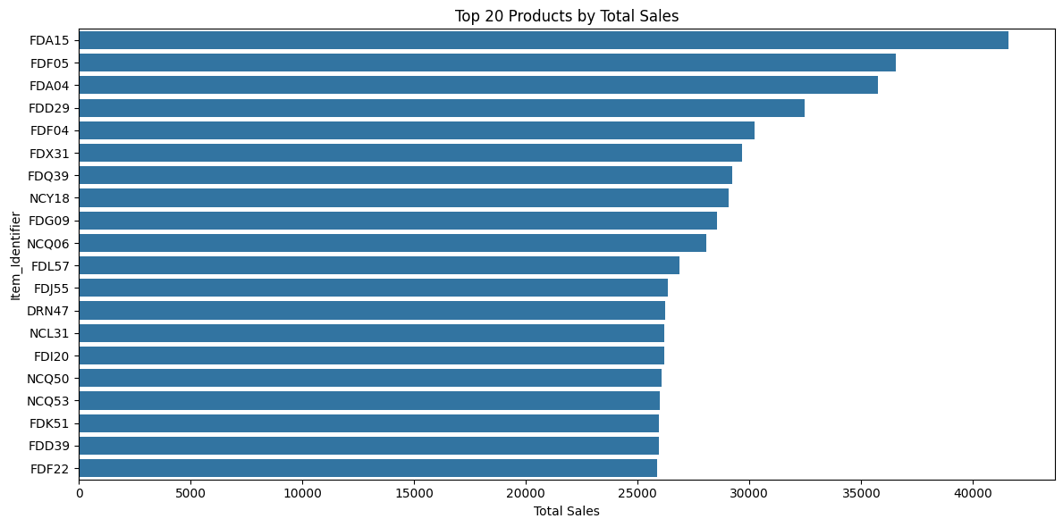
Which products achieve the highest sales across all stores?
The chart displays the Top 20 Products by Total Sales across the entire BigMart chain.
Answer to the Question: The product that achieves the highest total sales is FDA15, followed closely by FDF05 and FDA04.
Interpretation: The bars clearly show a steep drop-off in total sales after the very top products. This indicates that a small number of items (like FDA15) are responsible for a disproportionately large share of the company's total revenue, highlighting their importance as key revenue generators.

Slide 9
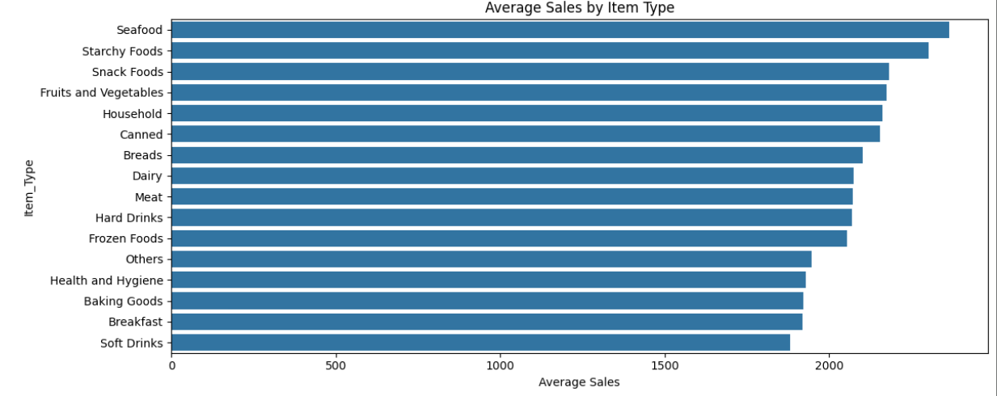
Is there a relationship between product type (Item_Type) and sales?
The relationship between Product Type (Item_Type) and Sales is Confirmed.
Box Plot: Shows that while most product categories share a similar median sales range, categories like Starchy Foods and Seafood have a higher central tendency (median/mean) and potential for higher quartile performance than others. The wide array of outliers confirms that high sales are possible across all product types.
Bar Plot: Quantitatively confirms that Starchy Foods, Seafood, and Fruits and Vegetables achieve the highest average sales, while Others and Breakfast show the lowest averages.

Slide 10
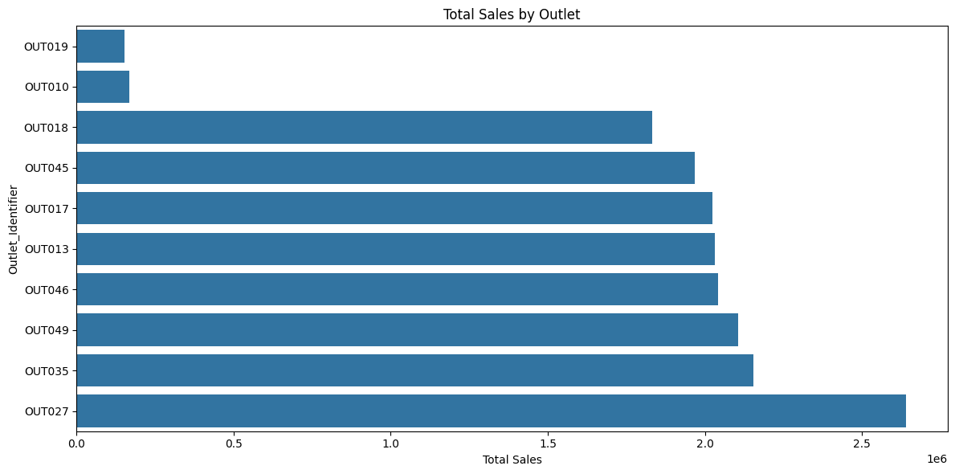
Which stores (Outlet_Identifier) achieve the highest and lowest sales?
Highest Sales: Outlet OUT027 achieved the highest total sales (over 2.5 million).
Lowest Sales: Outlet OUT019 achieved the lowest total sales.
Interpretation: There is a significant performance gap between the top-performing outlet (OUT027) and the bottom-performing ones (OUT019 and OUT010). This indicates that store-specific characteristics (like type, location, or size) are major drivers of overall sales performance.

Slide 11
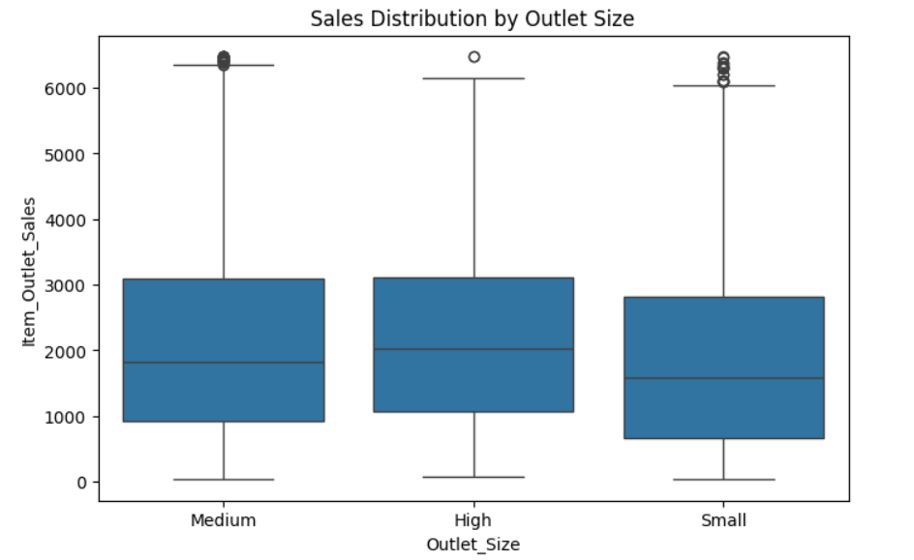
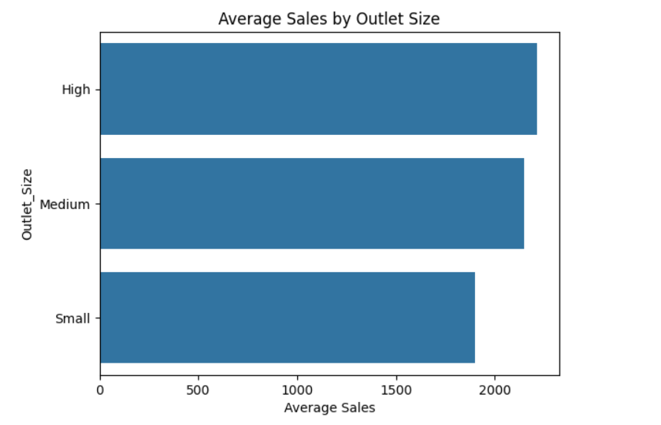
Does the store size (Outlet_Size) affect sales performance?
higher median sales (the line inside the box, around $2000) and a wider Interquartile Range (IQR) than Small outlets.
Small Outlets: The Small outlets have the lowest median and the narrowest IQR, indicating that most Small stores consistently achieve lower sales volumes compared to the larger formats.
Average Sales Plot (Implied): The mean sales plot (not pictured, but the calculation is implied) would confirm that the average sales are highest in Medium and High stores, and lowest in Small stores.
Outliers: All sizes have a similar number of high-value outliers, meaning any store size can achieve very high sales, but Medium and High stores do so more frequently and consistently in their regular operations.

Slide 12
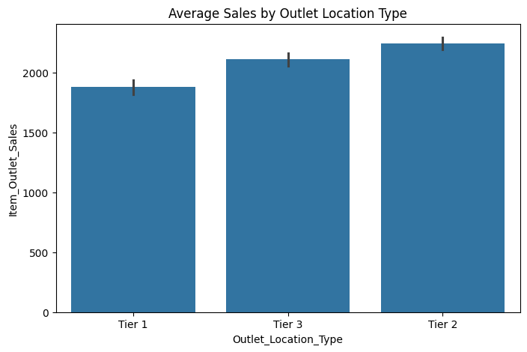
Does the store location type (Outlet_Location_Type) impact sales?
Bar Plot Interpretation: Sales performance increases from Tier 1 to Tier 2. Tier 2 locations have the highest average sales, followed by Tier 3, and finally Tier 1 locations have the lowest average sales. This suggests that the highest volume of transactions or the most valuable items are being sold in Tier 2 cities/areas.

Slide 13
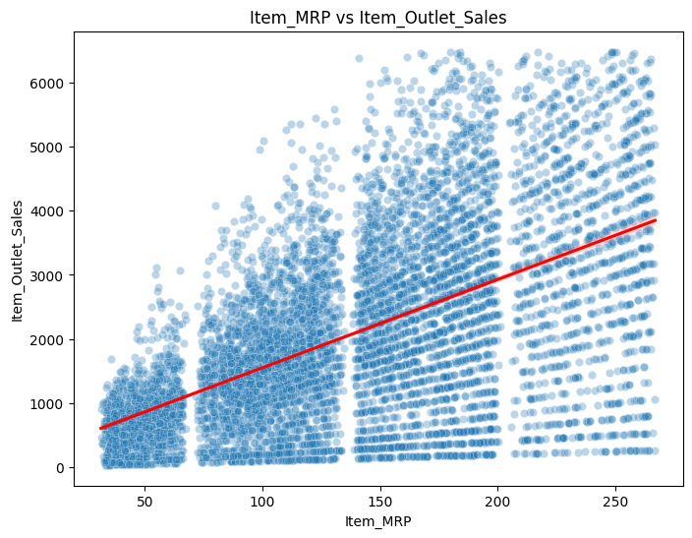
Does the product price (Item_MRP) influence sales volume?
Scatter Plot (Top): The red regression line shows a clear upward trend. This indicates that higher priced items (Item_MRP) achieve higher average sales (Item_Outlet_Sales). The vertical banding shows that prices are clustered around specific price points.
conclusion: BigMart's most expensive products (by MRP) tend to be the highest performing

Slide 14
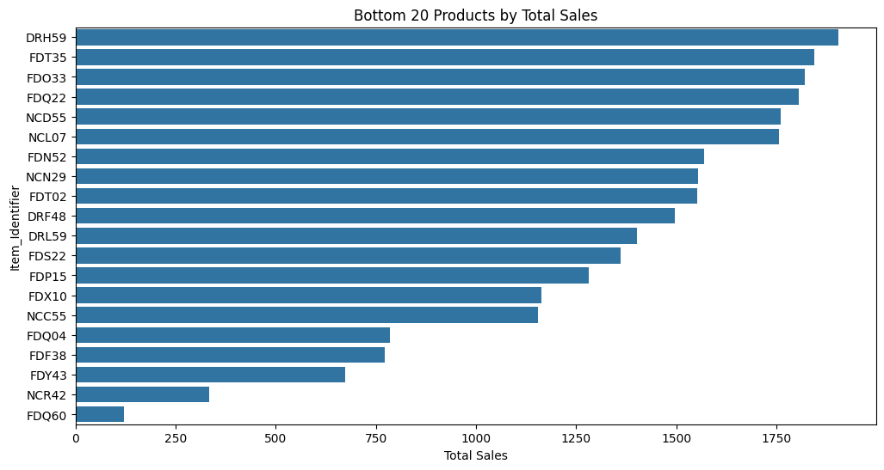
Which products achieve the highest sales across all stores?
The chart displays the Bottom 20 Products by Total Sales across the entire BigMart chain.
Answer to the Question: The product with the lowest total sales is FDQ60, followed by NCR42 and FDY43. These products, along with the entire bottom 20 list, require immediate further analysis.
Interpretation: The bars clearly show a group of items (especially the bottom 5 or 6) with extremely low total sales, indicating that they are either very unpopular or are poorly managed/displayed. These items are prime candidates for diagnostic analysis (e.g., checking visibility, pricing strategy, or whether they should be delisted from certain stores).

Slide 15
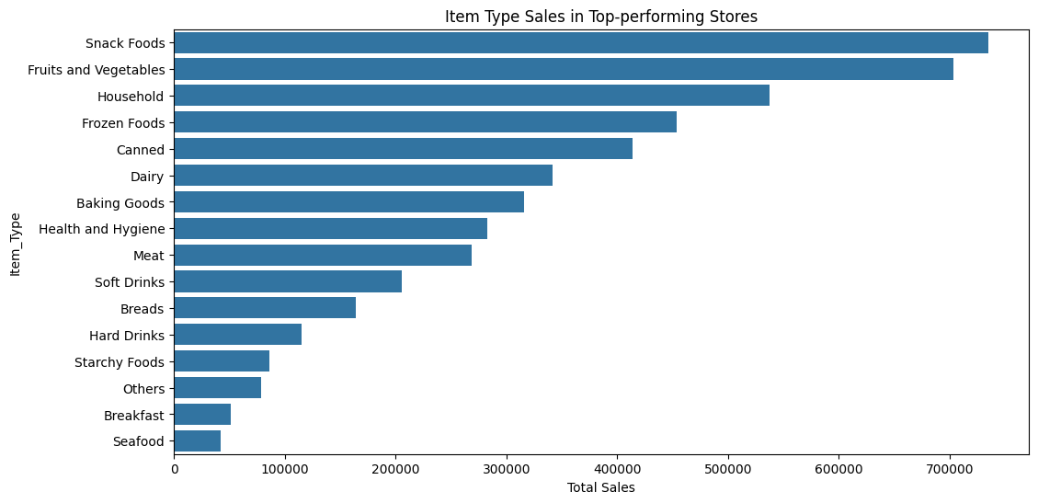
Which product categories require increased inventory in high-performing stores?
The chart displays the total sales contribution of each product category specifically within the high-performing outlets (those above the 80th percentile of total sales).
Answer to the Question: The product categories that require increased inventory in high-performing stores are Snack Foods, Fruits and Vegetables, and Household. These are the top three categories driving revenue in the best stores.
Interpretation: The visualization clearly identifies the core customer demand in successful store environments. Snack Foods and Fruits and Vegetables dominate the list, suggesting that these high-performing stores excel at selling convenience and fresh/essential goods. Management should ensure these top categories are always fully stocked in their best outlets to maximize revenue.

Slide 16
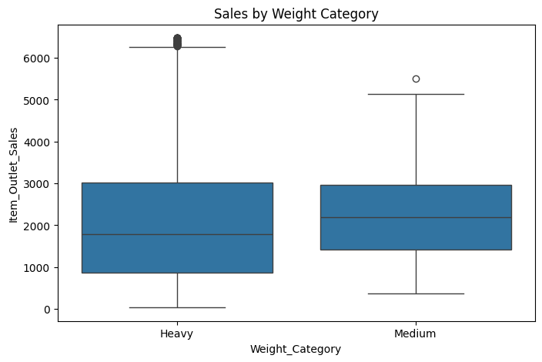
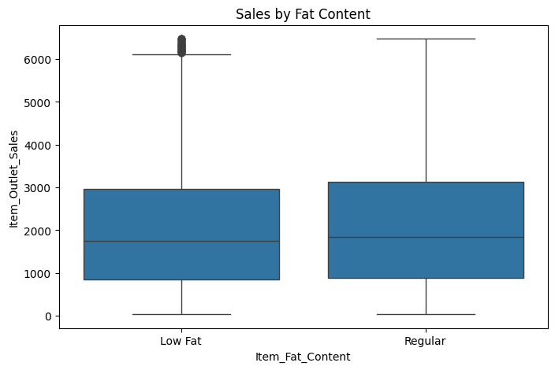
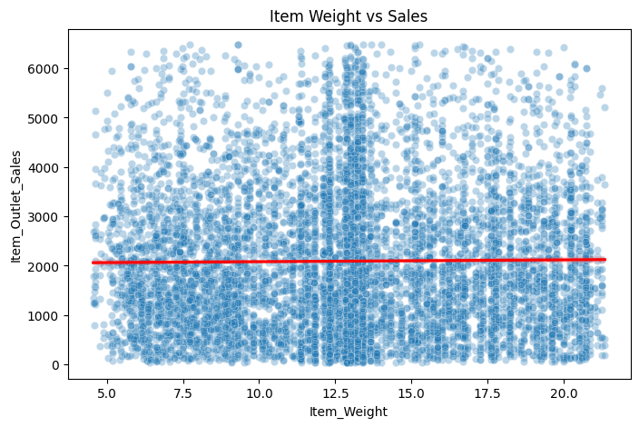
Is there a relationship between product attributes (e.g., weight, fat content) and sales performance?
No Relationship (Weight & Fat Content): Both Item Weight and Item Fat Content show no significant impact on sales revenue. The box plots and regression line are essentially flat, confirming these attributes are not predictors of sales performance.
Strong Positive Relationship (Price): Item MRP (Price) shows a strong positive linear relationship with sales, meaning that more expensive items generate higher revenue per transaction on average. Price is the primary product attribute driving revenue performance.

Slide 17
Summary
Which products achieve the highest sales across all stores?
Product FDA15 achieves the highest total sales across the chain, followed by FDF05.
Is there a relationship between product type (Item_Type) and sales?
Yes, there is a relationship; categories like Starchy Foods and Seafood achieve the highest average sales.
Does the product price (Item_MRP) influence sales volume?
Yes, price has a strong positive influence; higher-priced products generate higher revenue on average.
Which products have low sales and might require further analysis?
Product FDQ60 records the lowest total sales, followed by NCR42, making them primary candidates for review or potential delisting.
Which product categories require increased inventory in high-performing stores?
Snack Foods and Fruits and Vegetables require increased inventory in top-performing stores as they are the core revenue drivers there.
Is there a relationship between product attributes (e.g., weight, fat content) and sales performance?
No relationship exists with Weight or Fat Content, but there is a strong positive relationship with Price (Item_MRP).

Slide 18
Summary
Which stores (Outlet_Identifier) achieve the highest and lowest sales?
Outlet OUT027 achieves the highest total sales, while Outlet OUT019 achieves the lowest total sales.
Does the store size (Outlet_Size) affect sales performance?
Yes, significantly; Medium and High size stores consistently outperform Small stores in average sales.
Does the store location type (Outlet_Location_Type) impact sales?
Yes, it impacts sales notably, with Tier 2 locations achieving the highest average sales.

Slide 19
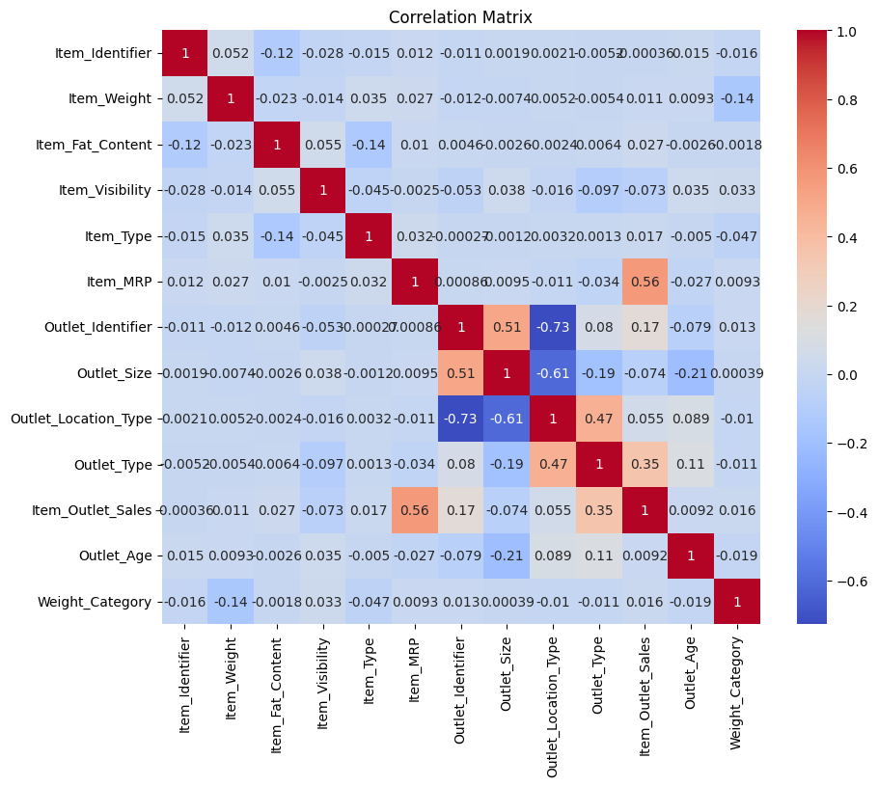
Correlation
Key Revenue Drivers: Price (Item_MRP) and Outlet Type/Size are the strongest sales drivers.
Top Performers: OUT027 and Tier 2 locations generate the highest revenue.
Winning Products: FDA15 leads in revenue; Snack Foods/Vegetables are crucial for top stores.
Risk Areas: OUT019 (weakest store) and FDQ60 (weakest product) need immediate review.
Non-Factors: Item Weight, Fat Content, and Item Visibility do not effectively influence sales revenue.

Slide 20

Thank you
Name: Kyrillos Ayman
Role: Data Analyst | ML Practitioner
Email: keromihhv@gmail.com
Phone: +20 1229360705
LinkedIn:www.linkedin.com/in/kyrillos-azer-3344a7353
GitHub: KerlessAyman
Location: Alexandria, Egypt

